Slide 1

CSC364-Software Engineering Week-1 Lecture-2 Semester-# Fall 2018
Prepared by:
M. Sajid Farooq

Slide 2
Instructor Contact Details
Name: M. Sajid Farooq
Course Instructor: CSC364- Software Engineering
Credit Hours: 3
Designation : Lecturer
Office Location: CS-Staff Room Cabin Sr#15
Email: msajidfarooq@lgu.edu.pk
Visiting Hours: Monday- Tuesday (1430-1600)
Lab Work: Video Tutorials & Supervision by Instr

Slide 3
Course Objectives
The main objective of this course is to provide a detailed view to Software Engineering and related topics.
The students will learn about the technical as well as the management side of Software Engineering.
They will acquire knowledge about fundamental principles of Software Engineering and also about practical approaches to securing Software Engineering.
Moreover, students should be able to work on UML and Software Engineering.

Slide 4
Software Development
Software Development Activities
Construction Activities
Management Activities

Slide 5
Construction Activities
Requirement Gathering
Design Development
Coding
Testing

Slide 6
Management Activities
Project planning and management
Configuration Management
Software Quality Assurance
Installing And Training

Slide 7
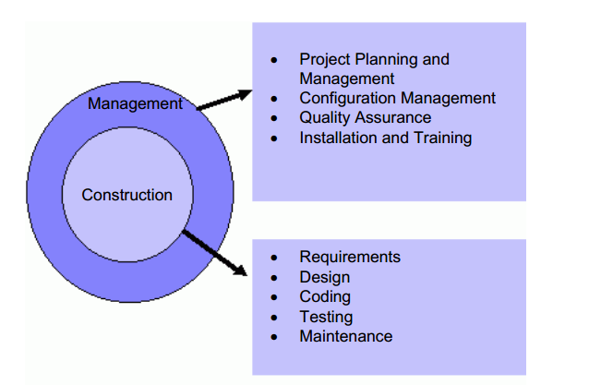
Software Development Activities

Slide 8
Software Engineering Framework
Task Set
Quality Focus
Processes
Methods
Tools

Slide 9
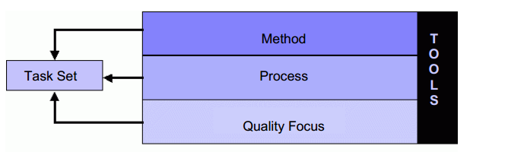
Software Engineering Framework

Slide 10

Software Engineering Phases

Slide 11
Software Engineering Phases
Vision: Here we determine why are we doing this thing and what are our business objectives that we want to achieve.
Definition: Here we actually realize or automate the vision developed in first phase. Here we determine what are the activities and things involved.
Development: Here we determine, what should be the design of the system, how will it be implemented and how to test it.
Maintenance: This is very important phase of software development. Here we control the change in system, whether that change is in the form of enhancements or defect removal.

Slide 12
Capability Maturity Model Integration ( CMMI )
Capability Maturity Model Integration (CMMI) is a process level improvement training and appraisal program. Administered by the CMMI Institute, a subsidiary of ISACA (Information Systems Audit and Control Association).

Slide 13
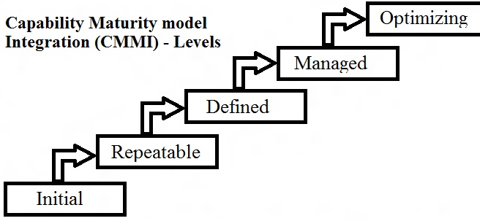
Capability Maturity Model Integration ( CMMI )

Slide 14
Software Myths
Managers need to understand that buying hardware and adding people does not spontaneously solve all software development problems.
Customers need to understand that computer software does not make all their other problems go away.
If the customer can not define his or her needs clearly, it is not possible to build a software product to meet these needs.
Software engineers must be committed to the concept of doing things right the first time.
Software quality does not happen on its own after a product is finished.
Quality must be built into every portion of the software development process.

Slide 15
The End

Slide 16
Q & A

Slide 17
References
These lecture notes were taken from following source:

